Slide 1
Digital Portfolio
STUDENT NAME: BLESSY.G
REGISTER NO AND NMID: 2428B0217/1E9362A473A0DD682E742C7F757DC744
DEPARTMENT: B.Sc COMPUTER SCIENCE WITH DATA ANALYTICS
COLLEGE: COLLEGE/ UNIVERSITY: TIRUPPUR KUMARAN COLLEGE FOR WOMEN /BHARATHIAR UNIVERSITY

Slide 2
PROJECT TITLE
Criminal pscycology Digital Portfolio

Slide 3


AGENDA
Problem Statement
Project Overview
End Users
Tools and Technologies
Portfolio design and Layout
Features and Functionality
Results and Screenshots
Conclusion
Github Link
3/21/2024 Annual Review

Slide 4

PROBLEM STATEMENT
Despite significant advancements in forensic science and investigative techniques, criminal psychology still faces challenges in accurately identifying, predicting, and preventing criminal behavior. One key issue lies in understanding the psychological factors—such as personality disorders, childhood trauma, and socio-environmental influences—that contribute to criminal activity. Traditional profiling methods often fail to capture the complexity of human behavior, leading to gaps in criminal investigations and rehabilitation programs.

Slide 5

PROJECT OVERVIEW
This project explores the psychological factors that influence criminal behavior and how these insights are applied in criminal investigations and rehabilitation. It focuses on understanding the role of personality traits, childhood trauma, and social environment in shaping criminal actions.
The study also examines criminal profiling techniques used in forensic psychology, their effectiveness in identifying suspects, and the ethical challenges they present. Additionally, it looks into rehabilitation approaches, such as cognitive-behavioral therapy and strength-based models, that aim to reduce reoffending and support reintegration into society.

Slide 6

WHO ARE THE END USERS?
Law Enforcement Agencies – Police officers and detectives use psychological profiling to investigate crimes and identify suspects.
Forensic Experts – Psychologists and criminologists apply behavioral analysis to provide insights during legal proceedings.
Judicial System– Judges, lawyers, and courts rely on psychological evaluations to assess criminal intent, mental health, and competency.
Community & Social services – Counselors and NGOs support reintegration of offenders into society using psychological approaches.

Slide 7
TOOLS AND TECHNIQUES
1. Psychological Assessment ToolsPersonality Tests (MMPI, Big Five) – To identify personality traits linked with behavior.
2. Interview & Observation TechniquesForensic Interviews – Structured questioning to assess motives, mental state, or deception.
3. Investigative ToolsCriminal Profiling – Creating offender profiles from crime scene evidence and behavior.
4. Rehabilitation & Treatment MethodsCognitive Behavioral Therapy (CBT) – To change distorted thinking and behaviors.
5. Research & Analytical ToolsCase Study Analysis – Deep dive into individual criminal histories.

Slide 8
POTFOLIO DESIGN AND LAYOUT
Design Principles
*Professional tone*: Use a formal, professional tone in your writing and design.
*Clear typography*: Choose clear, readable fonts and headings.
*Visual hierarchy*: Organize content using headings, subheadings, and bullet points.
*Consistent layout*: Use a consistent layout throughout the portfolio.
Layout Suggestion
*Introduction page*: Include a brief overview of the portfolio and your background.
*Case study sections*: Organize case studies into sections (e.g., violent crime, white-collar crime).
*Research and theory sections*: Include sections on research methods, theoretical frameworks, and applications.
*Assessment and intervention sections*: Showcase assessment tools and interventions used in criminal psychology.
8

Slide 9
FEATURES AND FUNCTIONALITY
Features
*Case studies*: Include real-life examples of criminal cases and how psychological principles were applied.
*Psychological assessments*: Showcase various assessment tools and techniques used to evaluate individuals involved in the justice system.
*Research-based content*: Highlight studies and findings that inform our understanding of criminal beaviour.
Functionality
*Interactive case simulations*: Create interactive scenarios that allow users to apply psychological principles to real-life cases.
*Assessment tools*: Include examples of psychological assessment tools, such as risk assessment instruments or personality inventories.
*Infographics and visualizations*: Use visual aids to illustrate complex psychological concepts and data.-collar crime).

Slide 10
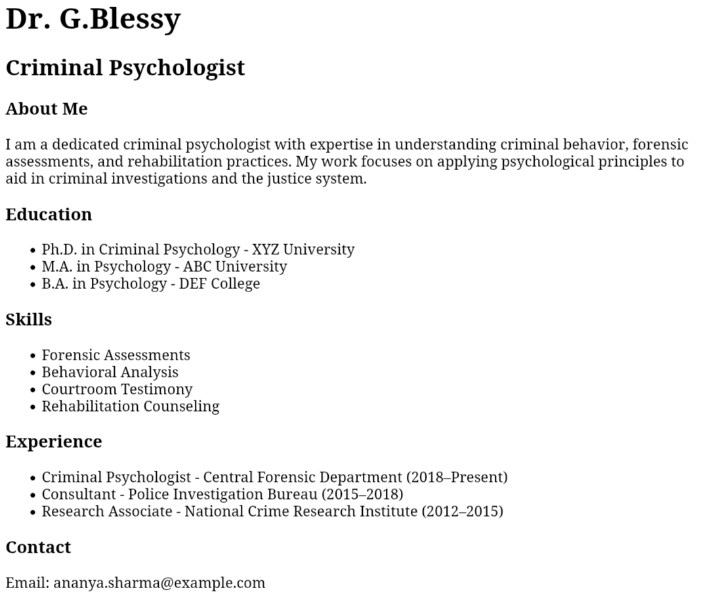

RESULTS AND SCREENSHOTS
3/21/2024 Annual Review
10

Slide 11
CONCLUSION
Criminal psychology plays a vital role in understanding criminal behavior, supporting investigations, and promoting justice. By applying psychological principles to law enforcement and the legal system, it helps identify motives, predict patterns, and assist in rehabilitation. This field not only contributes to solving crimes but also works toward creating safer communities and reducing future offenses.
11

